Slide 1
Just Don’t App
Bruno Ross Shab

Slide 2
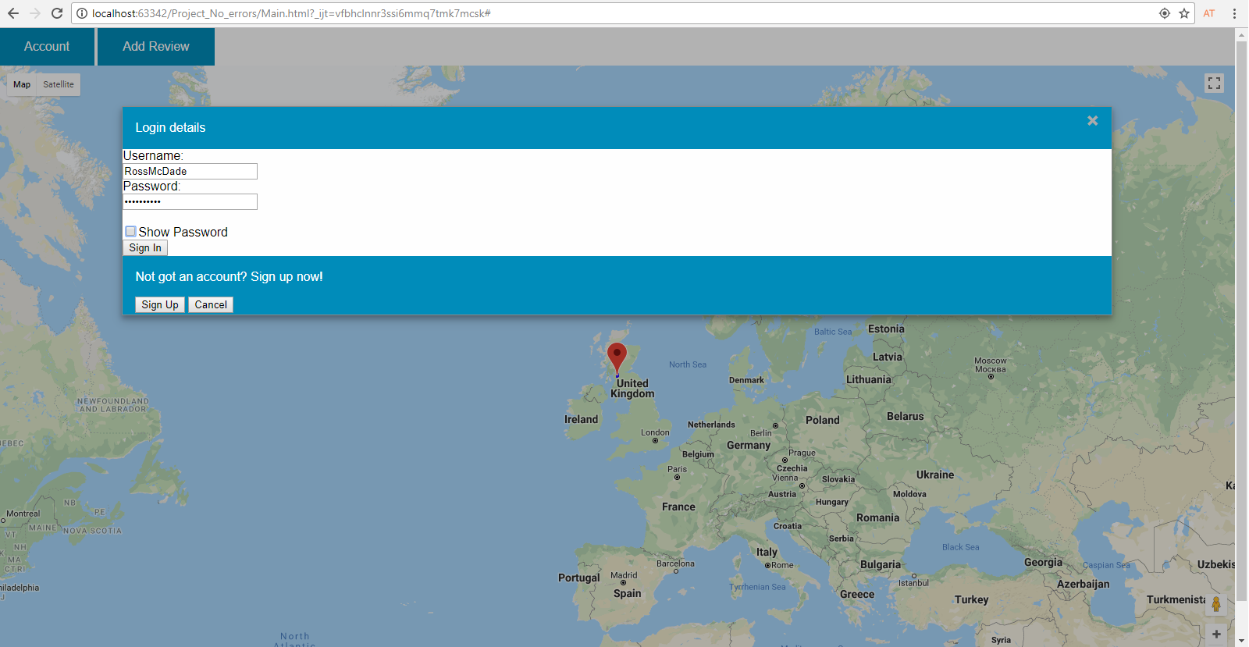

Buttons
Account button

Slide 3
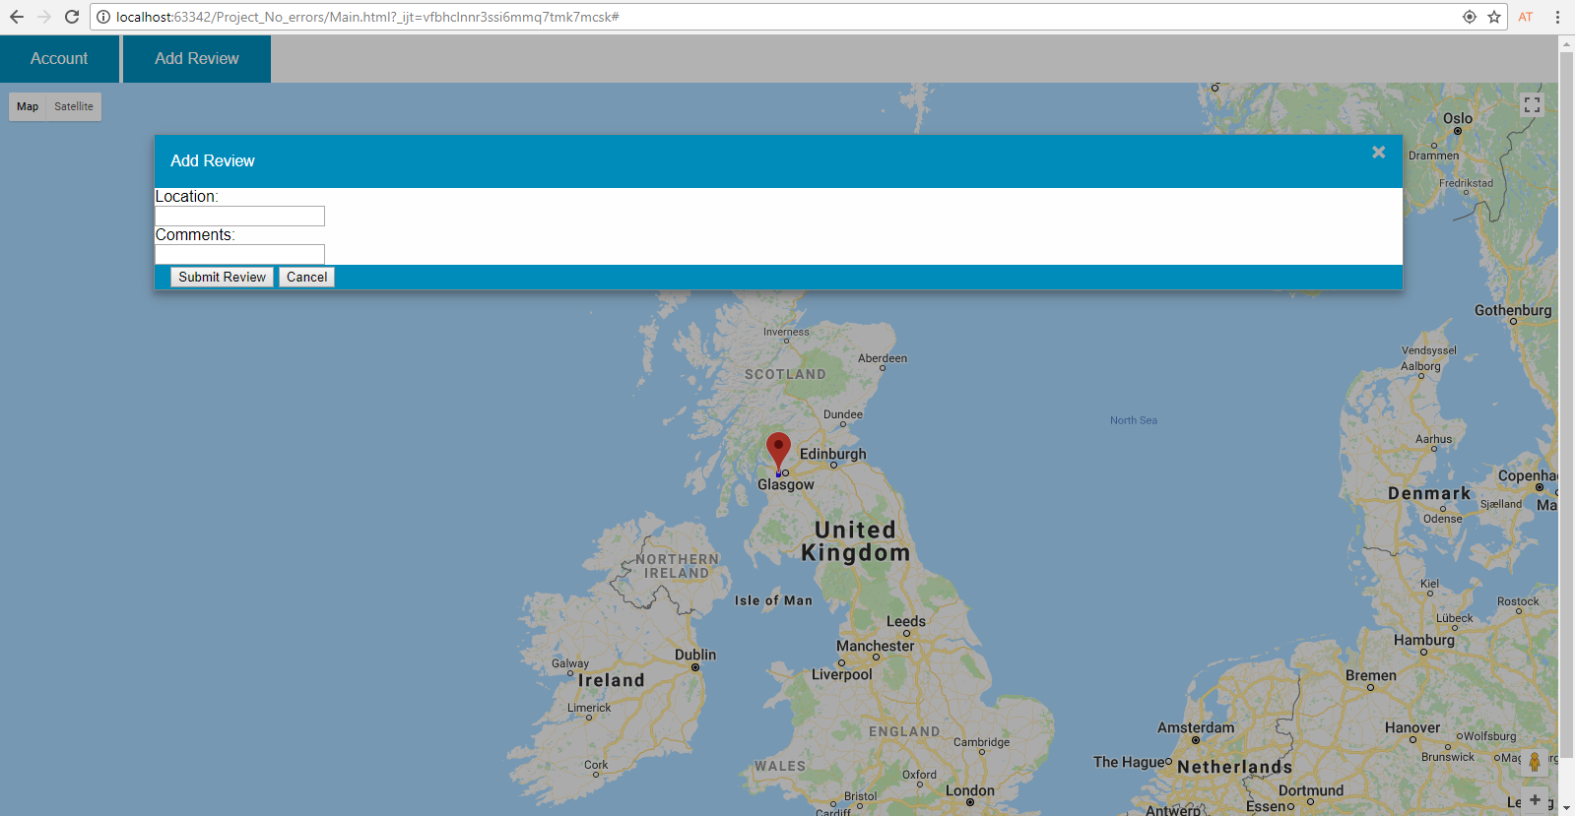
Buttons
Add Review button

Slide 4
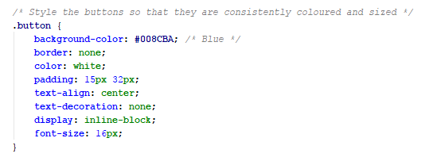

Buttons
Button code

Slide 5
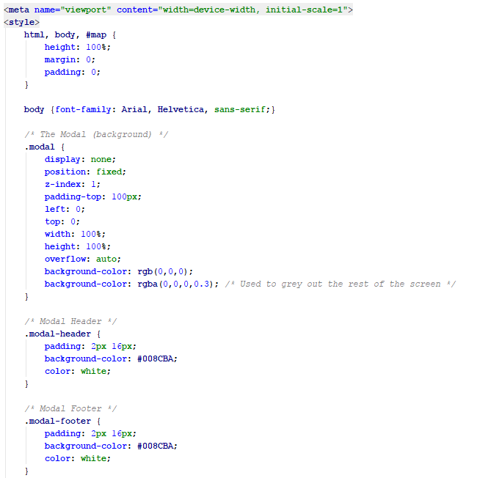
Modals
Modals CSS code

Slide 6
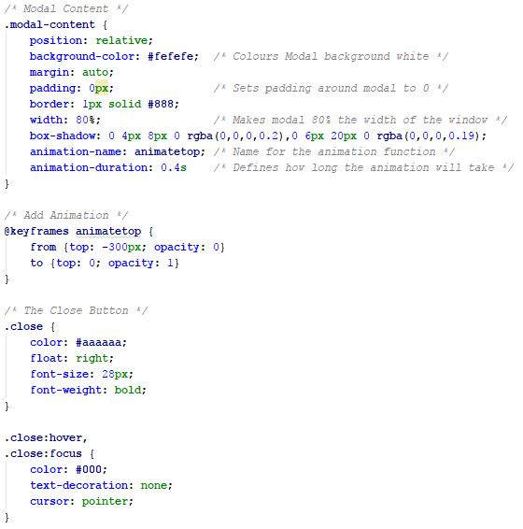
Modals
Modals CSS code

Slide 7
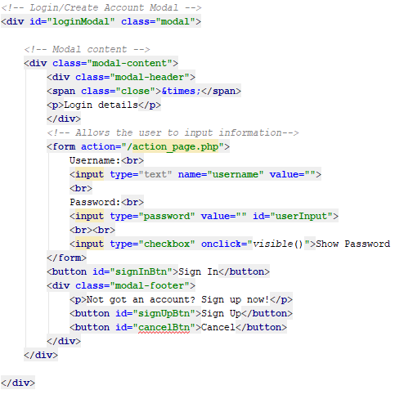
Modals
Login Modal code

Slide 8
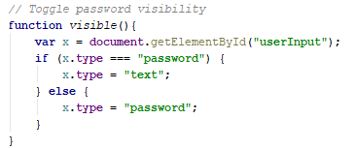
Modals
Login Modal code

Slide 9
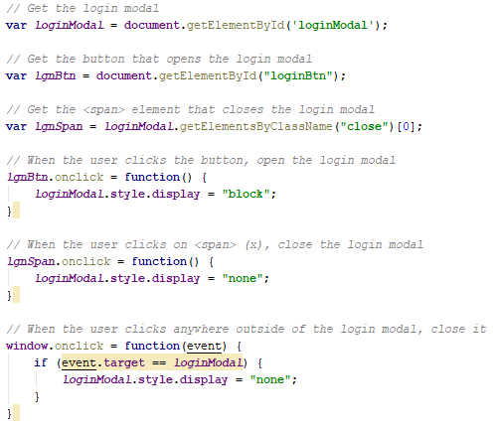
Modals
Login Modal code

Slide 10
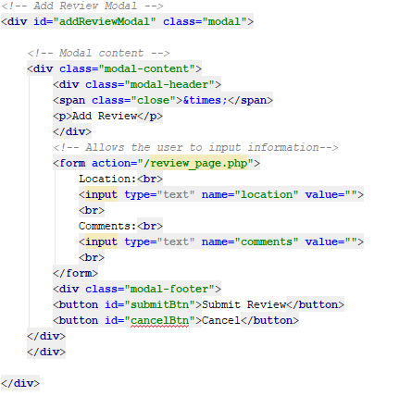
Modals
Add Review code

Slide 11
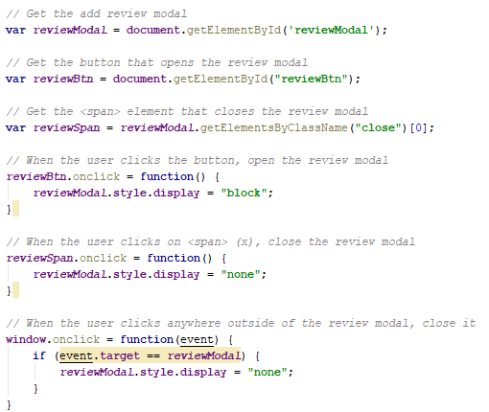
Modals
Add Review code

